Slide 1
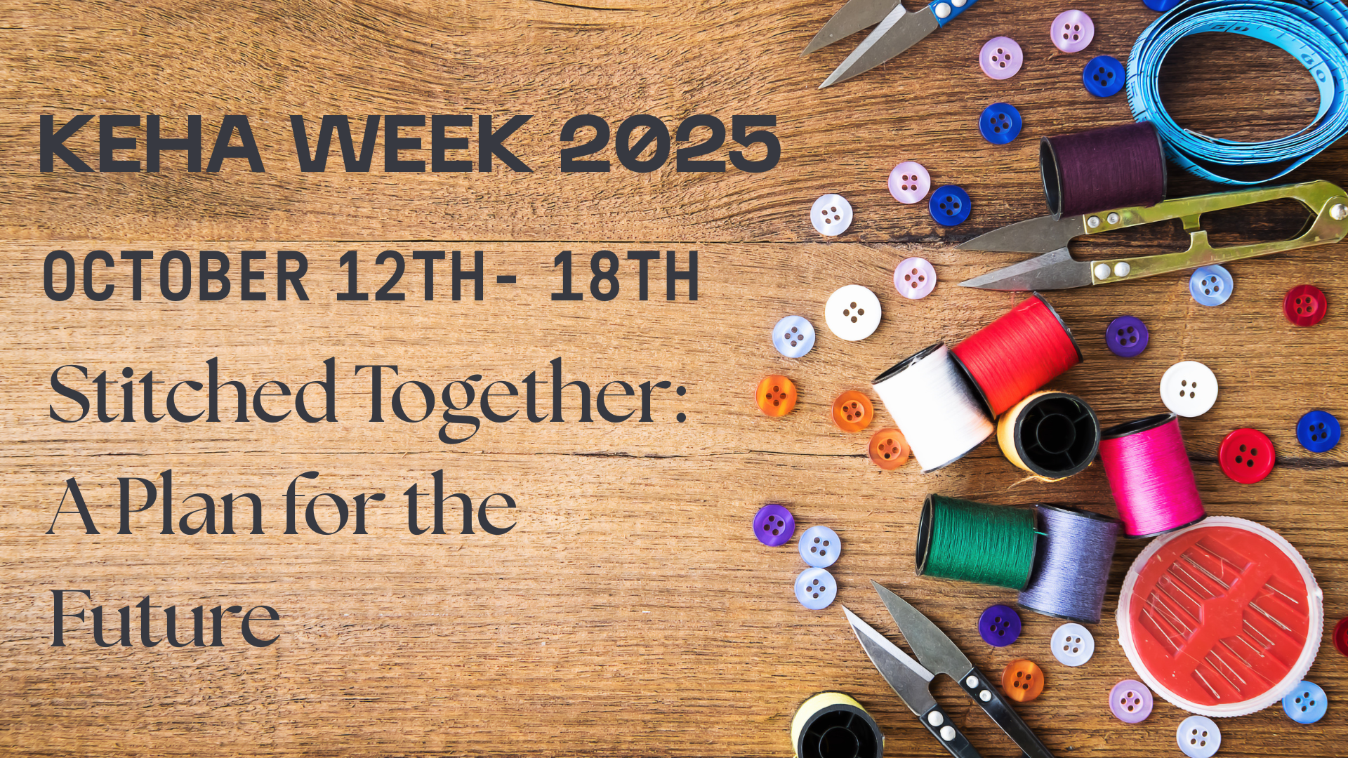

Slide 2
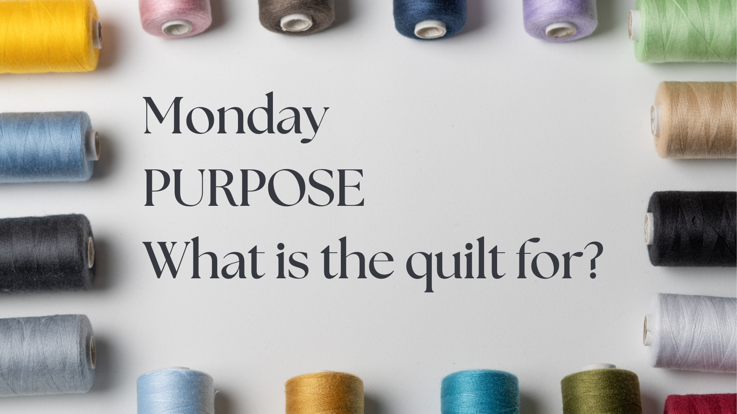
Notes:
Just like every quilt begins with a reason—so does every Homemaker’s journey. 💗
Whether you're here to celebrate, remember, teach, or connect—your “why” is what stitches your story into our fabric.
KEHA invites you to design your personal “Sewing Plan” for the future.
➡ What’s your purpose?
➡ Who are you reaching?
➡ Why does it matter?
Join us. Share your story. Stitch your purpose into something beautiful.

Slide 3

Notes:
Every quilt begins with a plan—and so does every successful KEHA project. 🎯
Planning is where creativity meets intention. What’s your “pattern”? A class? A community dinner? A welcome to new members?
🧷 Use KEHA’s Program of Work like your pattern.
🎨 Pick your fabric—skills, volunteers, and passion.
🧵 Cut, stitch, and make something memorable.
Your Sewing Plan starts now. Let’s create it—together.

Slide 4

Notes:
It’s time for Show & Tell! 🧵✨
When you follow your Sewing Plan, what do you get? A finished quilt—and a community impact.
🧶 Taught someone a new skill?
🧺 Made care baskets?
📸 Shared on social media or at state conference?
Then your quilt is done—and beautiful. Don’t forget to showcase your story, celebrate your efforts, and inspire someone else.

Slide 5

Notes:
Our quilt isn’t finished yet—and it won’t be until you add your square. 🧩
In KEHA, every member is a piece of the design. Your talents, your laugh, your ideas—they make the fabric stronger.
Thinking about joining? This is your sign.
You belong here, and your square will fit just right.

Slide 6

Notes:
Quilts last generations. So does KEHA. 🧓👩‍🦰👧
When you join Homemakers, you're stitching today’s dreams into tomorrow’s legacy.
Your Sewing Plan helps build the future—one square, one event, one conversation at a time.
We’re not just crafting quilts—we’re crafting Kentucky’s future.

